Slide 1
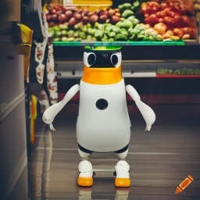
ECE4078 Intelligent Robotics
AI art generated by https://www.craiyon.com/
(prompt: “a penguin robot shopping for fruits and vegetables in a supermarket”)
Lab 1: Setup and Teleoperation

Slide 2
ECE4078 Intelligent robotics
The aim of the project is to develop a grocery shopping robot.
You will be required to search, identify, locate and “pick-up” target fruits and vegs on a shopping list using a PenguinPi robot in a “supermarket” (arena).
Within the “supermarket” there will be “aisle labels” (ARUCO markers) to help the robot locate itself and the targets.
Each of the labs will focus on a subsection of the task, i.e., the lab milestones.

Slide 3
ECE4078 Intelligent robotics
2 checkpoints + 3 milestones + a final demo
Submission deadline is right before the start of the due lab session
Week | Objectives | Milestones
1: C1-1 | Introduction and setup
2: M1-1 | Calibration, ARUCO markers | C1 due
3: M1-2 | SLAM
4: M1-3 | SLAM
5: M2-1 | Object recognition & localisation | M1 due
6: M2-2 | Object recognition & localisation
7: M3-1 | Navigation & Planning | M2 due
8: M3-2 | Navigation & Planning
9: C2 | Integration & Improvement | M3 due
10: Final | Trial run of final demo | C2 due
11: Final | Final demo | Final demo due
12: No lab | N/A | N/A
*
Submit code
before your lab
session

Slide 4
ECE4078 Intelligent robotics
Checkpoints are non-assessed, but gets you ready for the milestones / demos.
Milestones account for 20% of your unit grade. The final demo will account for 60% of your unit grade (no final exam).
M1 – 8%
M2 – 6%
M3 – 6%
You’ll work in teams of 5 (except for C1). You will register your group in week 2, so feel free to meet and mingle with people this week!
During a marking session, each group will present their submission to the demonstrators.
Further instructions on Moodle and Github repo
EdStem will be used for this semester

Slide 5
This week’s lab
1: Installing the environment
Instructions can be found on GitHub under “Week00-01” folder – “EnvironmentSetup.md”
2: Implement teleoperation
Skeleton code is provided: “operate.py” but not compulsory to use
C1 (marked as individuals): - Drive forward
- Drive backwards
- Turn left
- Turn right
3: You may ask to be marked during this week’s lab if you finish early (submit your code on Moodle first following the marking steps)

Slide 6
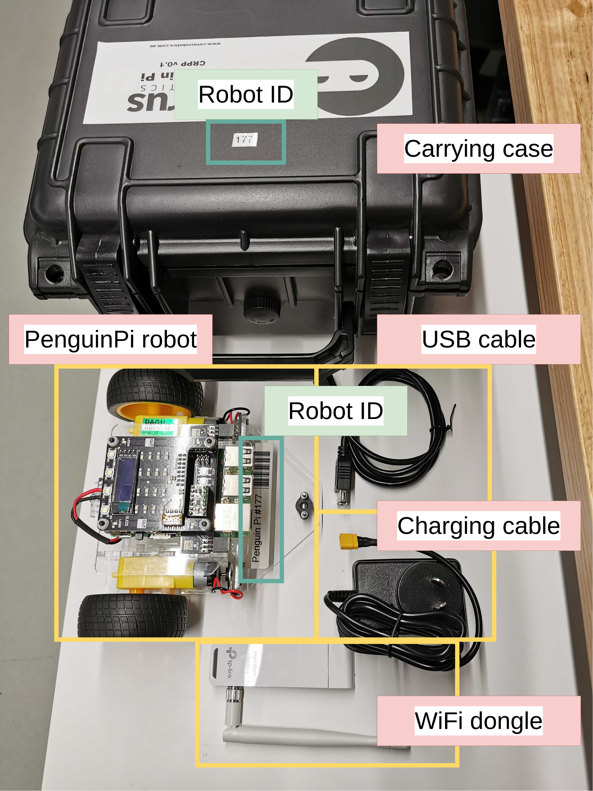
Inside the robot kit
(from next week each group can bring a robot home)

Slide 7
Plugging and disconnecting the robot cable through the yellow connector (not the black cable itself!)
If wires are exposed, do NOT solder it yourself. Ask for a replacement PenguinPi, and we will get the professional staff to resolder

Slide 8
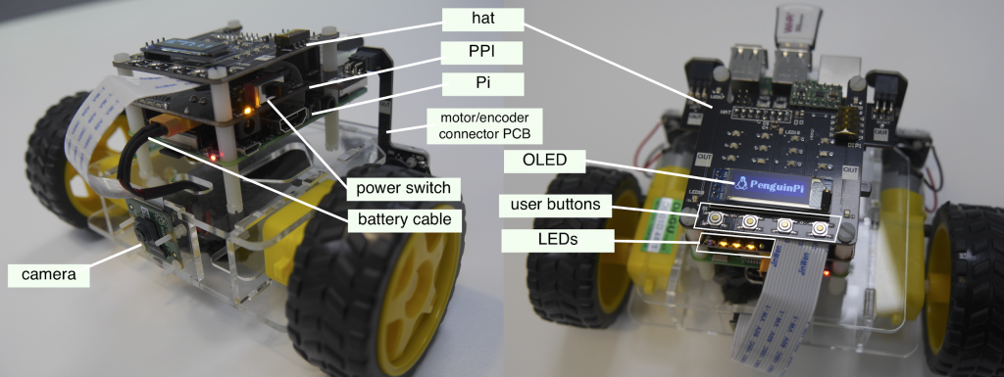
The PenguinPi robot: see “EnvironmentSetup.md”

Slide 9
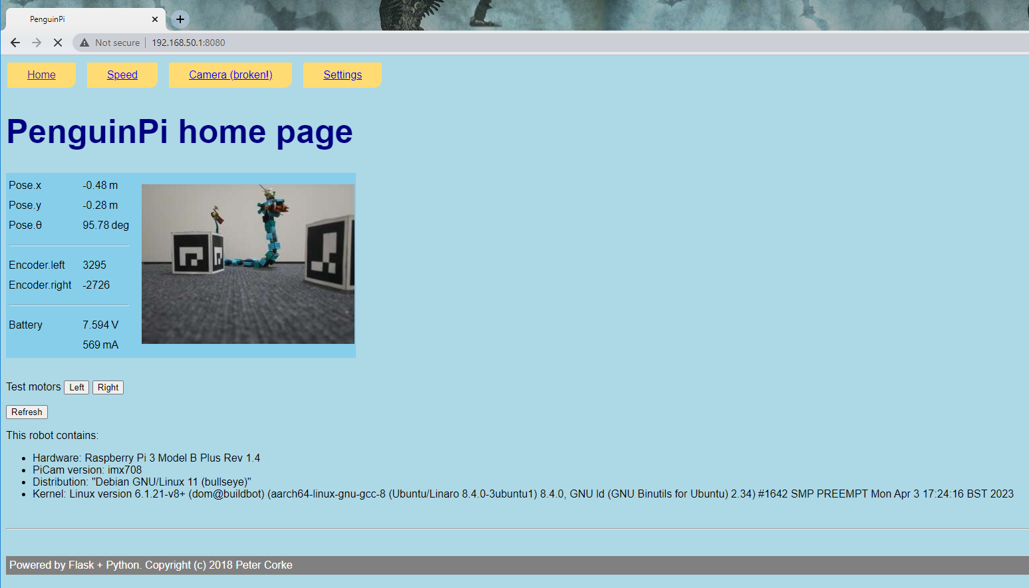
Connect to robot: webpage may not be working, but it is okay to proceed to the command-line tasks

Slide 10
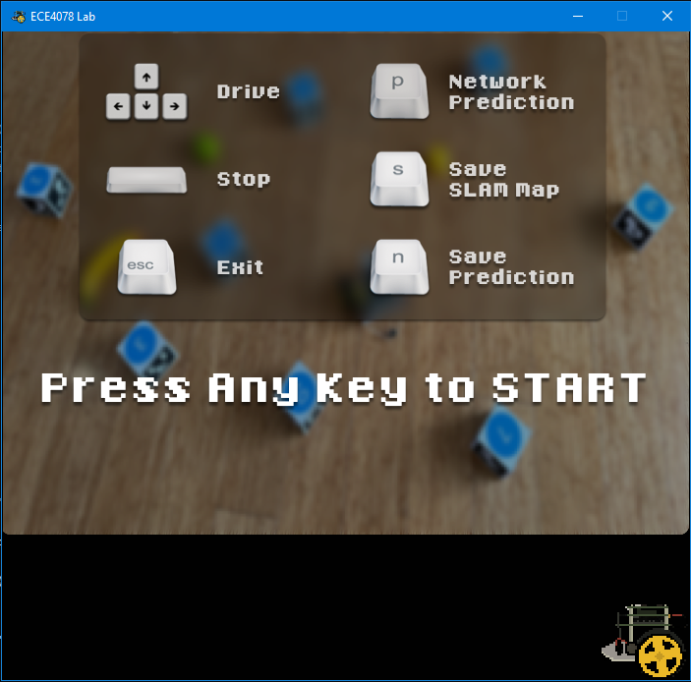
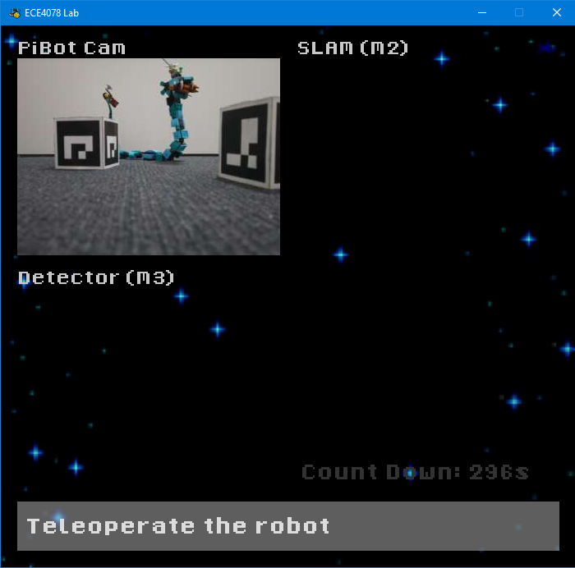
Running teleoperation (GUI needs to work)

Slide 11



Additional recommendations (optional)
- Install a python IDE (pick one)
PyCharm
Spyder
Visual studio code
Or anything else familiar to you
- Extension to basic teleoperation functions (Optional):
Implement variable speed control
Implement arc turning & on spot turning
Turn off sticky keys (robots stops when not holding a button)
Implement time normalisation (Perform an iteration every N milliseconds compared to as fast as possible)

